Slide 1

VMAIL-Voice based email assistant
Minor project
ATHULLYAMOL S R
S3 MCA

Slide 2
abstract
In the present scenario, everybody needs communication technology to connect with each other. Communication technologies are significant these days for the betterment of social and personal interaction. The combination of technologies with the internet makes communication easy. However, the person who is physically challenged suffered a lot to utilize this technology due to visual and physical difficulties. There are many technologies advancements have come though it is not possible to use like normal users. This paper aims at creating an email system that helps even new users or physically impaired people to use the system for communication without any previous practices. There is no use of keywords, only with the help of mouse actions and voice conversion the email system works. The person who is not literate can also send emails as it is based on speech recognition and text to speech. The system is completely based on responsive voice interaction to utilize the technology easy and hassle free manner. The system is well designed to send the mails quickly. There are all the options available to send emails and perform all the functions for the email system.

Slide 3
introduction
Nowadays everybody is connected to the internet. It is an inseparable part of our life. It contains all the information of individuals and day to day history. Communication and interaction are possible mainly through the internet. Out of many technologies Email is the most common way of communication primarily for business and educational perspective. Although not all use net and have access. This is due to lack of facilities, knowledge and money. The users should have vision to see and read the screen. For the physically and visually challenged people net is like a useless and unfamiliar thing. However, there are technologies like TTS (text-to-speech), and ASR (automated-speech recognition) screen readers, but they do not provide full accuracy and efficiency to the impaired people to use the internet. As communication is needed in everyone’s life, net facilities should be available for everyone.

Slide 4
Existing system
According to Email Statistics Report, 2014-2018 by a technology market research firm Palo Alto, CA, USA, there are a total of 4.1 billion email accounts created until 2014 to over 5.2 billion accounts in end of 2018 and making it one of the most used form of communication. The research, by the Vision Loss Expert Group (VLEG), shows that worldwide 253 million people are either blind or visually challenged that is, around 253 million people are not aware of how to use Internet or E-mail. Existing systems of today are basically applications that provide accessing of emails benefits to its users via web facilities. Making email widely used communication form. The existing systems do not support any voice commands or audio facilities and therefore it is not suitable for visually challenged people.

Slide 5
Proposed system
Real Time Voice Assistant For Composing Mail and Reading Inbox
Sending Email
Reading Inbox mails
To Confirm The Intended Mail Credentials With The Help Of Voice Assistant

Slide 6





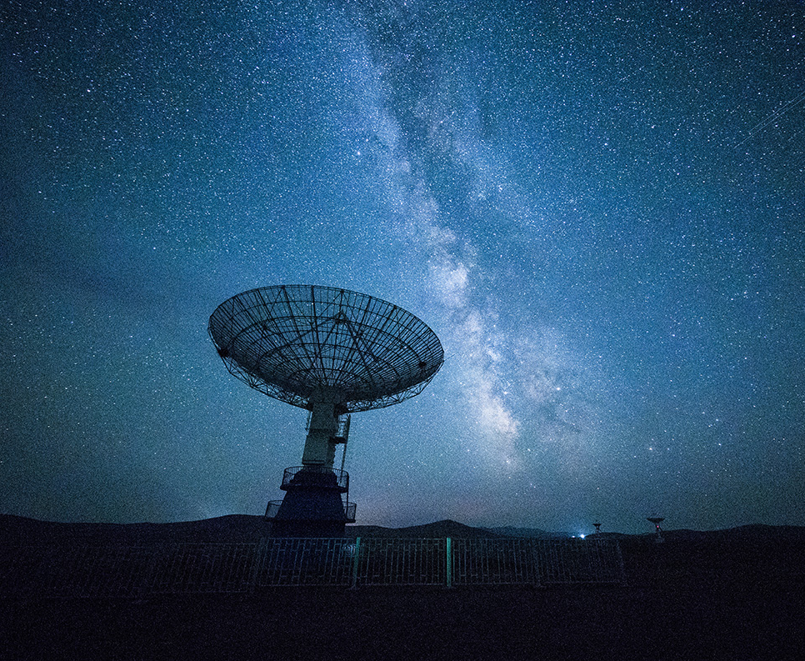

Technologies used
TECHNOLOGIES
TOOLS
Python 3.10
Speech
Recognition
pyttsx3
smtplib
Canva
PyCharm
OBS Studio
easyimap

Slide 7
Process flow
Email & password
System Speaking
User input Microphone
Google web speech api
Reading Mail
1. Login
2. Google Text To Speech
3. Speech Recognition
6. Imap Protocol
5. Smtp Protocol
4. Validate Mail_List
Fetch Inbox Mail
smtplib api
Pre Known Email address
Sending Mail

Slide 8
Screenshots

Slide 9
CONclusion
In future, we attempt to make the system keyboard free and fully voice based. So it's easy for the visually impaired people to access the services. The system developed now is working only on desktops. As use of mobile phones is emerging as a trend today, there is a scope to incorporate this facility as an application in mobile phones also. Also, security measures to be implemented during the login phase can be revised to form the system safer.

Slide 10

Thank You!

